Slide 1

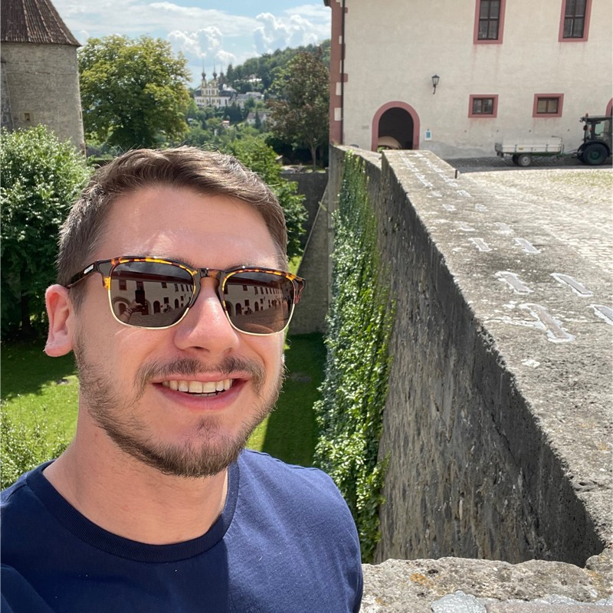
CyberWarefare in Russia-Ukraine confict
Ashu Sharma
Ryan Estes

Slide 2
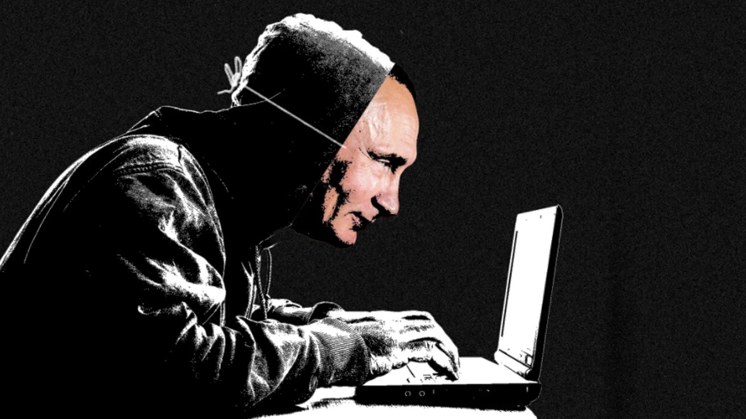

Agenda
Introduction
How It Started
What is Cyberwarfare?
Threat Landscape
A New Battlefield
The Russian/Ukraine Conflict
Threat Actors
Major Malware involved
Cyberwarfare Timeline
Technical Analysis
ISAACWiper (Ryan)
Azov Ransomware (Ashu)
Threat Hunting
YARA Rules
VirusTotal Query (Azov)
Sample Hashes
Recommendation
Directions for preventions
References
Q&A

Slide 3
Introduction

Slide 4
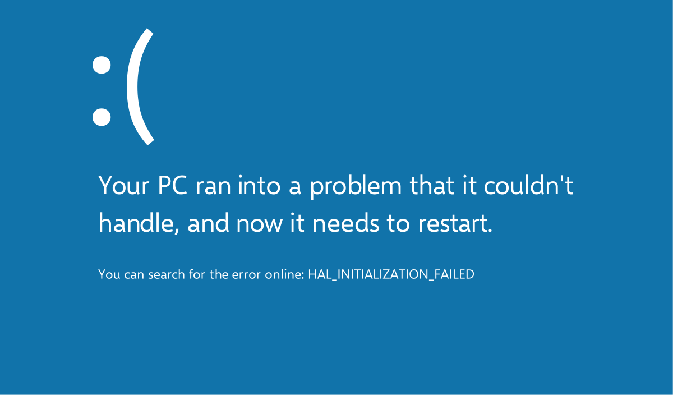
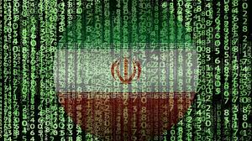
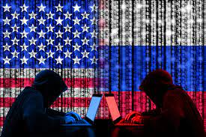
The Beginnings of Cyberwarfare
A customer in Iran reported arbitrary BSODs and computer reboots and responded with a Windows OS misconfiguration.
Observed persistence.
58% of devices in Iran were infected, and nobody knew what the purpose of the code was.
Highly skilled hackers used zero-day vulnerabilities.
Notes:
The Man Who Found Stuxnet – Sergey Ulasen
Blue screen of death
#https://www.youtube.com/watch?v=U_7CGl6VWaQ
#https://eugene.kaspersky.com/2011/11/02/the-man-who-found-stuxnet-sergey-ulasen-in-the-spotlight/
#https://www.wilderssecurity.com/threads/rootkit-tmphider.276994/#post-1712134

Slide 5
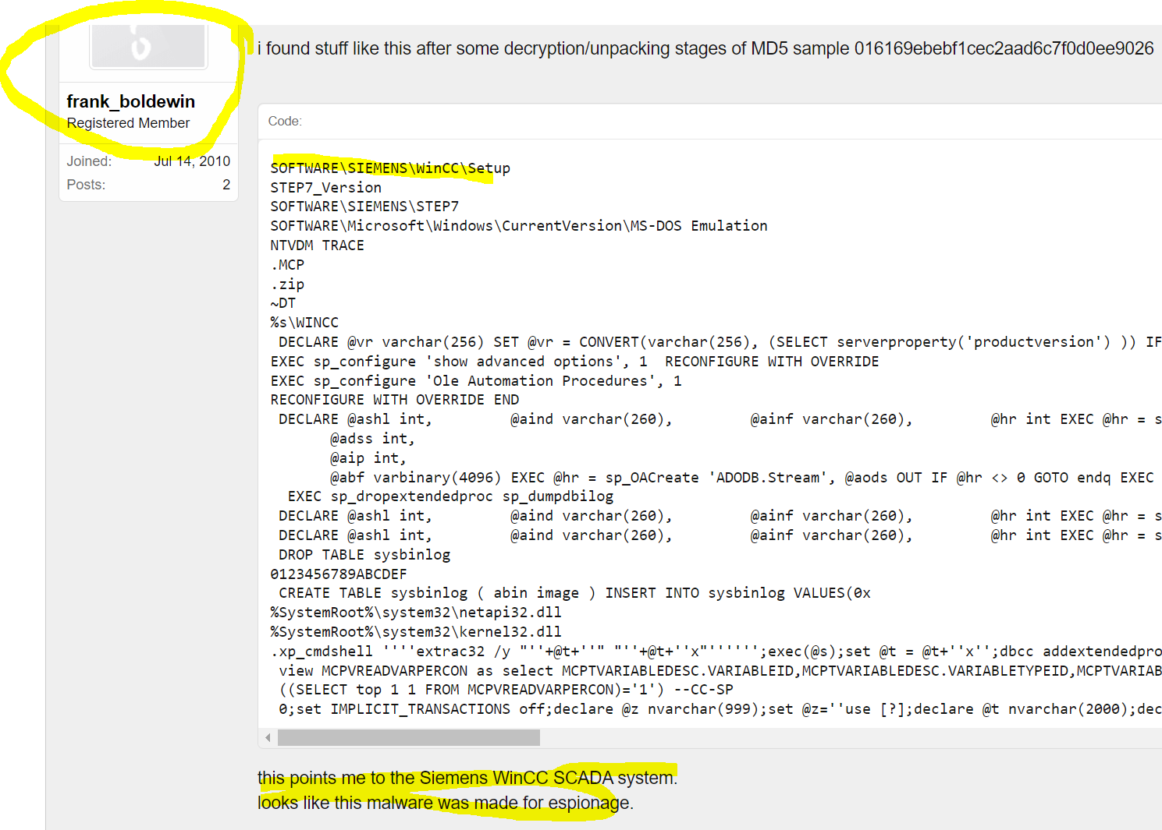
The Beginnings of Cyberwarfare

Slide 6
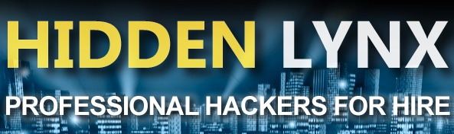

The Beginnings of Cyberwarfare
The Stuxnet drivers were signed with genuine digital certificates from respected companies.
Said it was an option.
And then Estates comes into business.
Detections were delayed.
Pay to exploit hackers; buy exploits and keep zero days.
Notes:
The Man Who Found Stuxnet – Sergey Ulasen

Slide 7
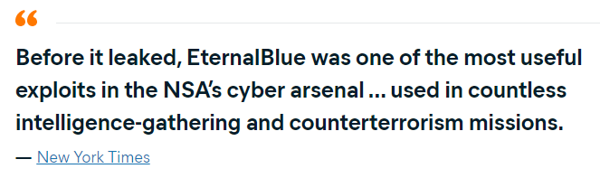
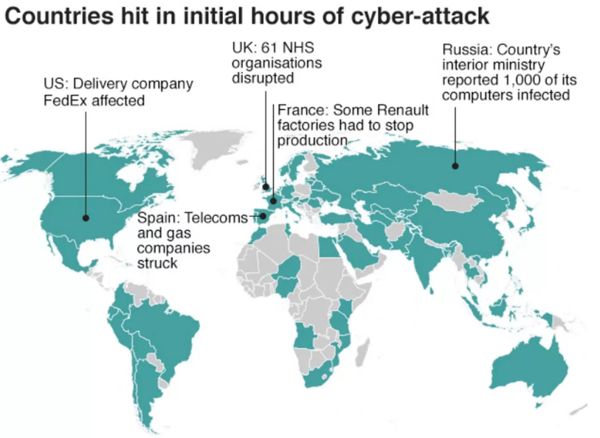
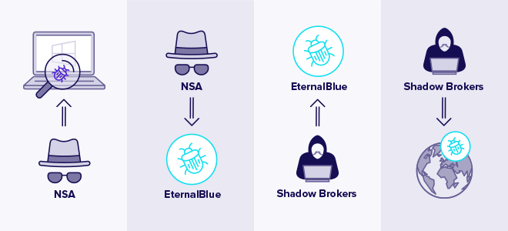
Game of Exploits

Slide 8
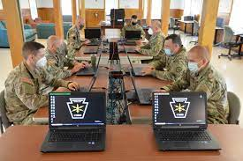
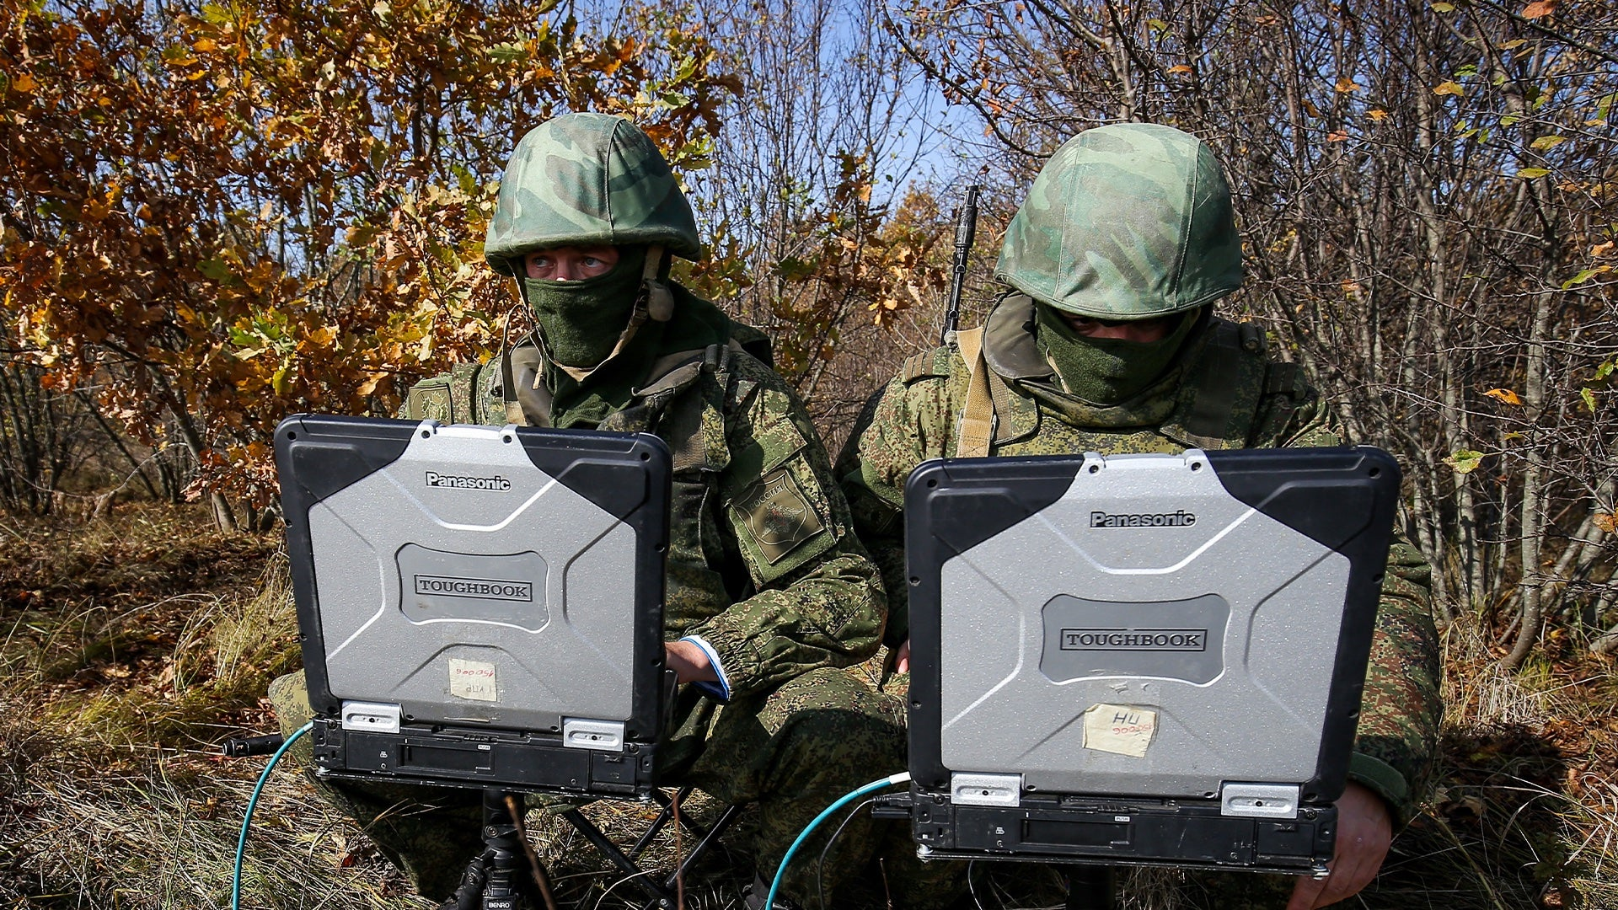
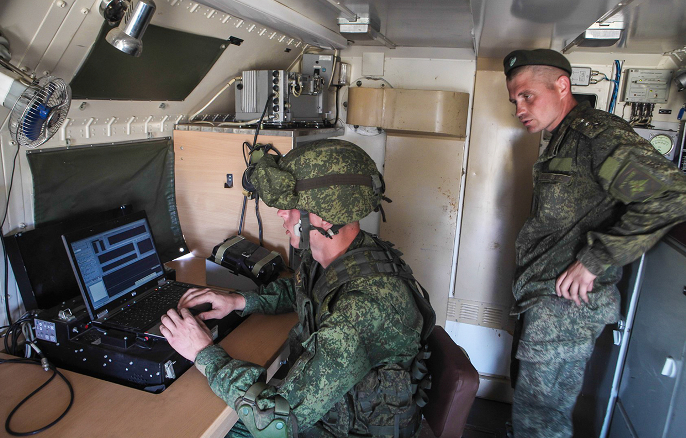
A New Battlefield
#https//www.imperva.com/learn/application-security/cyber-warfare/#~text=Cyber%20warfare%20is%20usually%20defined,and%20even%20loss%20of%20life.

Slide 9
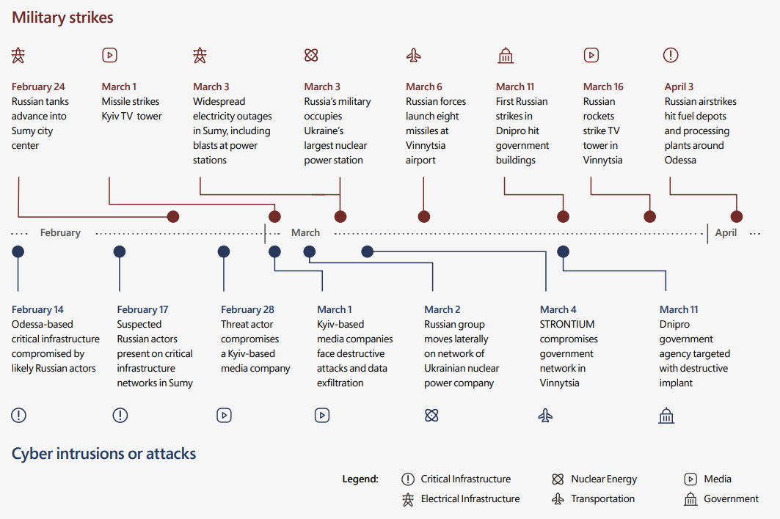
Early Attacks in the Conflict
https//query.prod.cms.rt.microsoft.com/cms/api/am/binary/RE4Vwwd

Slide 10
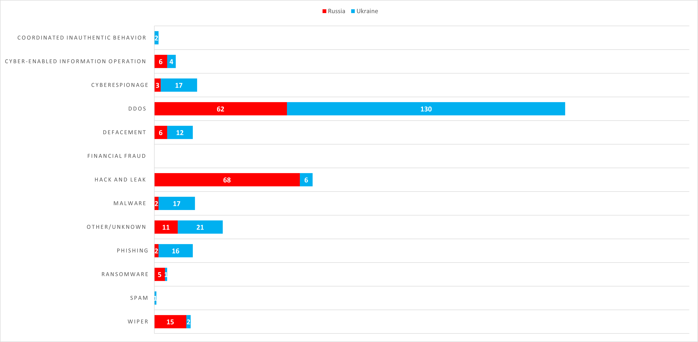
Cyberwarfare Attack Types

Slide 11
Threat Actors

Slide 12
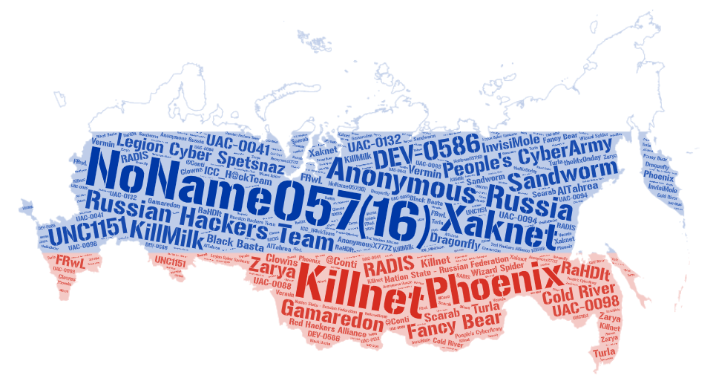
Threat Actors (Russia)
Allegiance to Russia
Name | Type | Country | Attacks
NoName057(16) | Collective | Russia | 171
Anonymous Russia | Nation State | Russia | 100
Killnet | Collective | Russia | 85
People's CyberArmy | Collective | Russia | 64
Russian Hackers Team | Collective | Unknown | 19
Phoenix | Collective | Russia | 18
Sandworm | Nation State | Russia | 16
Xaknet | Individual | Russia | 14
DEV-0586 | Collective | Russia | 10
Legion Cyber Spetsnaz | Collective | Russia | 8
Fancy Bear | Collective | Russia | 8
UNC1151 | Collective | Belarus | 7
Gamaredon | Collective | Russia | 6
Nation State - Russian Federation | Collective | Russia | 5
Cold River | Collective | Russia | 3
KillMilk | Collective | Russia | 3
RADIS | Cybercriminal | Unknown | 3
UAC-0098 | Unknown | Russia | 2
UAC-0041 | Collective | Russia | 2
Zarya | Collective | Russia | 2
ICC_H@ckTeam | Collective | Russia | 2
Many more … | Collective | … | …
Data derived from https://cyberconflicts.cyberpeaceinstitute.org

Slide 13
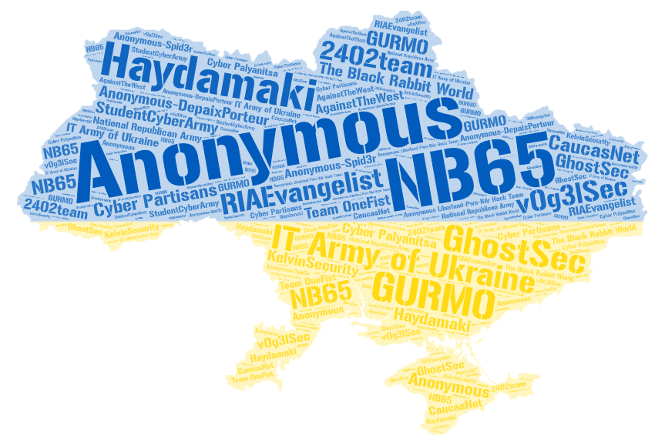
Threat Actors (Ukraine)
Allegiance to Ukraine
Name | Type | Country | Attacks
Anonymous | Collective | Unknown | 55
IT Army of Ukraine | Nation State | Ukraine | 39
NB65 | Collective | Unknown | 9
Haydamaki | Collective | Ukraine | 9
GhostSec | Collective | USA | 4
Anonymous-DepaixPorteur | Collective | Unknown | 3
GURMO | Nation State | Ukraine | 2
RIAEvangelist | Individual | USA | 2
The Black Rabbit World | Collective | Unknown | 2
StudentCyberArmy | Collective | Ukraine | 2
v0g3lSec | Collective | Unknown | 2
Cyber Partisans | Collective | Belarus | 2
2402team | Collective | Unknown | 1
Cyber Palyanitsa | Collective | Ukraine | 1
National Republican Army | Collective | Russia | 1
AgainstTheWest | Collective | Unknown | 1
KelvinSecurity | Cybercriminal | Unknown | 1
CaucasNet | Unknown | Unknown | 1
Team OneFist | Collective | Ukraine | 1
Anonymous-Spid3r | Collective | Unknown | 1
Anonymous Liberland-Pwn-Bär Hack Team | Collective | Unknown | 1
Data derived from https://cyberconflicts.cyberpeaceinstitute.org

Slide 14
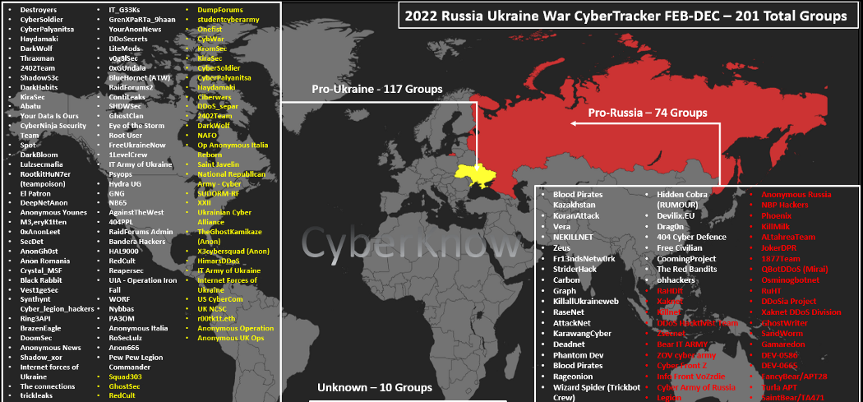
Threat Actors (CyberKnow)

Slide 15
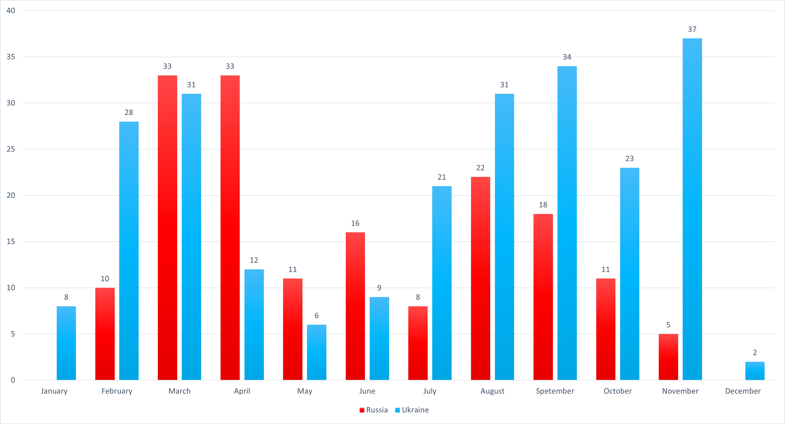
Reported Incidents by Month

Slide 16
UA/RU Novel Wipers Timeline

Slide 17
Timeline of Novel Wipers in Ukraine
WhisperGate
- The first novel wiper of the year
- Two-stage pseudo-ransomware
- Attributed to DEV-0586 (Russia)
- (JAN13) Also UNC1151 (Belarus)
DesertBlade
- Used in combination with missiles
- Targeted media company
- Attributed to unknown Russian threat actors
CaddyWiper
- Successfully used in multiple attacks (MAR14, APR1, APR8)
- Attacks Windows and Linux
- Attributed to Sandworm (Russia)
HermeticWiper HermeticWizard HermeticRansom
AcidRain
IsaacWiper
Official Start of Conflict
- Discovered the day before conflict
- targeted Viasat, disrupting comms
- UA, FR, DE, HU, GR, IT, PL
- Attributed to Russian Government
- First wiper preceding conflict
- Signed certificate “Hermetica”
- HermeticRansom == PartyTicket
- HermeticRansom used as decoy
- Attributed to Sandworm (Russia)
- Discovered alongside HW and AR
- Shares no code similarity to either
- Compilation as early as Oct2021
- Attributed to Sandworm (Russia)
- On the morning of February 24th, Putin announced a “special military operation” in Ukraine, marking the official beginning of the conflict.
FEB22
FEB23
FEB28
JAN12
FEB23
FEB24
MAR13

Slide 18
Timeline of Novel Wipers in Ukraine (cont.)
DoubleZero
- Two-stage wiper
- Each stage overrides with 0s
- Hence the name: “DoubleZero”
- Attributed to UAC-0088 (RU, BY)
Somnia Ransomware
- No known successful attacks
- pseudo-ransomware (wiper)
- Attributed to FRwL (Russia)
RansomBoggs
- Appears to be a “one and done.”
- crypto-ransomware
- Uses Monsters Inc. references
- No known samples discovered in wild
Industroyer2
ORCSHRED AWFULSHRED SOLOSHRED
Prestige Ransomware
Azov Ransomware
- ORCSHRED – Linux worm
- AWFULSHRED & SOLOSHRED – Solaris and Linux wipers
- Attributed to Sandworm (Russia)
- 2nd iteration of Industroyer (2016)
- Configurable malware targeting energy provider ICS systems
- Used with the 3 “Shreds” and CW
- Attributed to Sandworm (Russia)
- Targeted UA & PO logistics orgs
- Ransomware with 3 delivery mechanisms
- Attributed to IRIDIUM (Russia)
- Still being used as of this writing
- Pseudo-ransomware and polymorphic worm
- Thousands of samples discovered
- Unknown attribution
APR8
OCT11
NOV11
MAR16
APR8
OCT27
NOV25

Slide 19
Novel Wipers (Not so Honorable Mentions)
CryWiper
- Wiper that masqueraded as ransomware
- Attack on Russian government entities
- Discovered in early December 2022
dnWIPE
Nominatus_ToxicBattery
- Only known data of this one is a tweet from an analyst from G-Data
- Wiper that overwrites files with copies of itself
- Not much else is known about this one
- Base64 encodes files
- Believed to be from authors of RU_Ransom
- Thus, likely targeted Russia
- Believed to be still in development (as of March)
RU_Ransom
- Another wiper that masqueraded as ransomware
- Has worming capabilities
- Retaliation for the first wave of wipers by Russia
- Attack on Russian entities
- Discovered in early March 2022

Slide 20
Technical Analysis (ISSACWiper)

Slide 21
ISAACWiper
Also known as LasainWiper/Lasainraw by Microsoft (I don’t know why)
The name “ISAACWiper” comes from ESET researchers who discovered the file and initially thought the MW used the ISAAC PRNG
It uses another PRNG that will be discussed later ☺
Discovered the day of the conflict (FEB24, 2022)
Another iteration of ISAACWiper was discovered a day later
Has debug strings
This is the sample I am analyzing
Reference: https://www.welivesecurity.com/2022/03/01/isaacwiper-hermeticwizard-wiper-worm-targeting-ukraine/

Slide 22


ISAACWiper Samples
13037b749aa4b1eda538fda26d6ac41c8f7b1d02d83f47b0d187dd645154e033
Sample Collected
7bcd4ec18fc4a56db30e0aaebd44e2988f98f7b5d8c14f6689f650b4f11e16c0
Sample Collected
abf9adf2c2c21c1e8bd69975dfccb5ca53060d8e1e7271a5e9ef3b56a7e54d9f
No Sample
afe1f2768e57573757039a40ac40f3c7471bb084599613b3402b1e9958e0d27a
No Sample

Slide 23
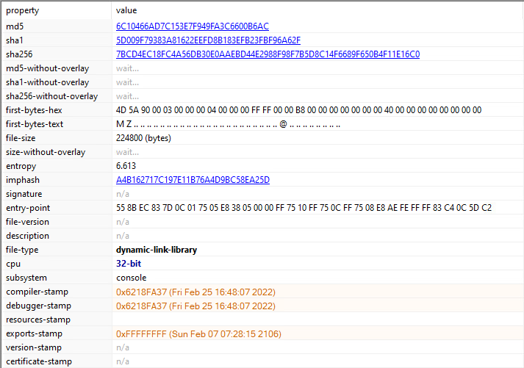
ISAACWiper Static Analysis

Slide 24
ISAACWiper Static Analysis (Tools)
Tools used:
PE Studio
Detect it Easy (DiE)
RDG Packer Detector
Professional PE file Explorer (Puppy)
CAPA
IDA
Hatching Triage (Online Sandbox)
Many Microsoft documentation lookups ☺

Slide 25
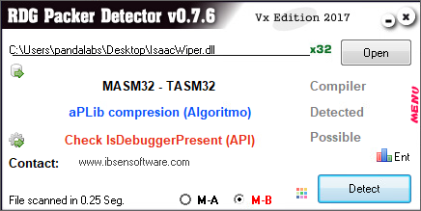
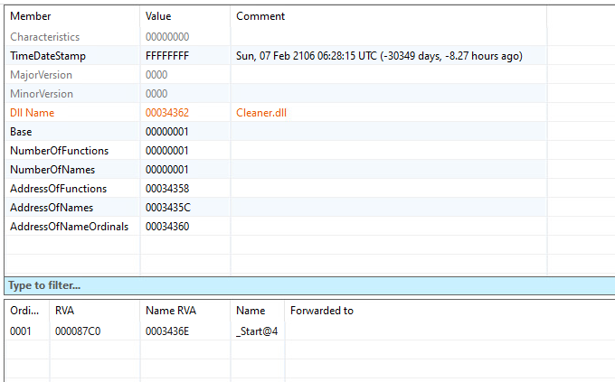
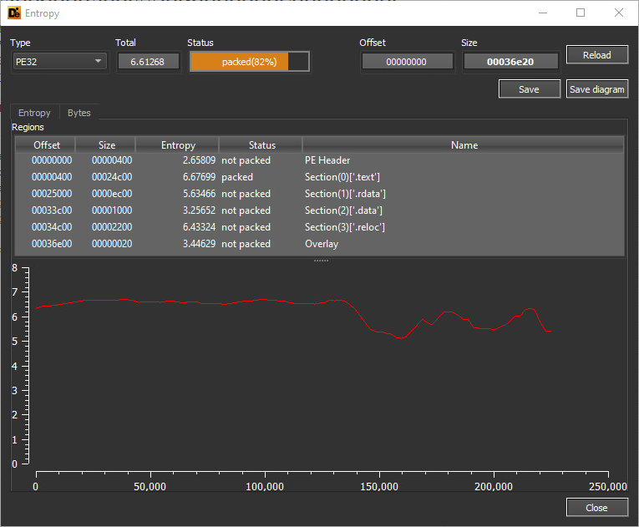
ISAACWiper Static Analysis

Slide 26
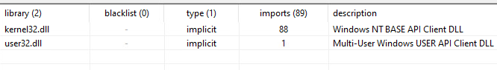
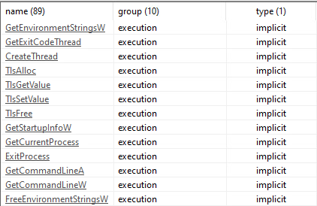
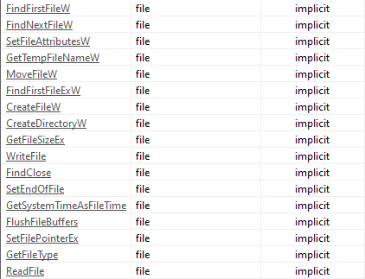
ISAACWiper Static Analysis (Libraries)
Libraries
Execution
File

Slide 27
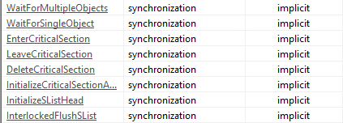
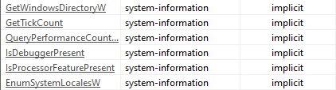
ISAACWiper Static Analysis (Libraries)
Synchronization
System-Information
Storage

Slide 28
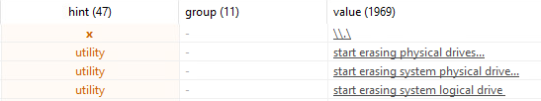
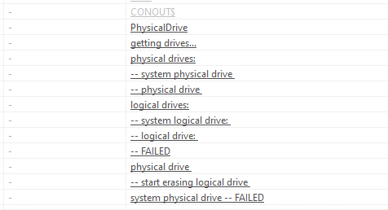
ISAACWiper Static Analysis (Strings)

Slide 29
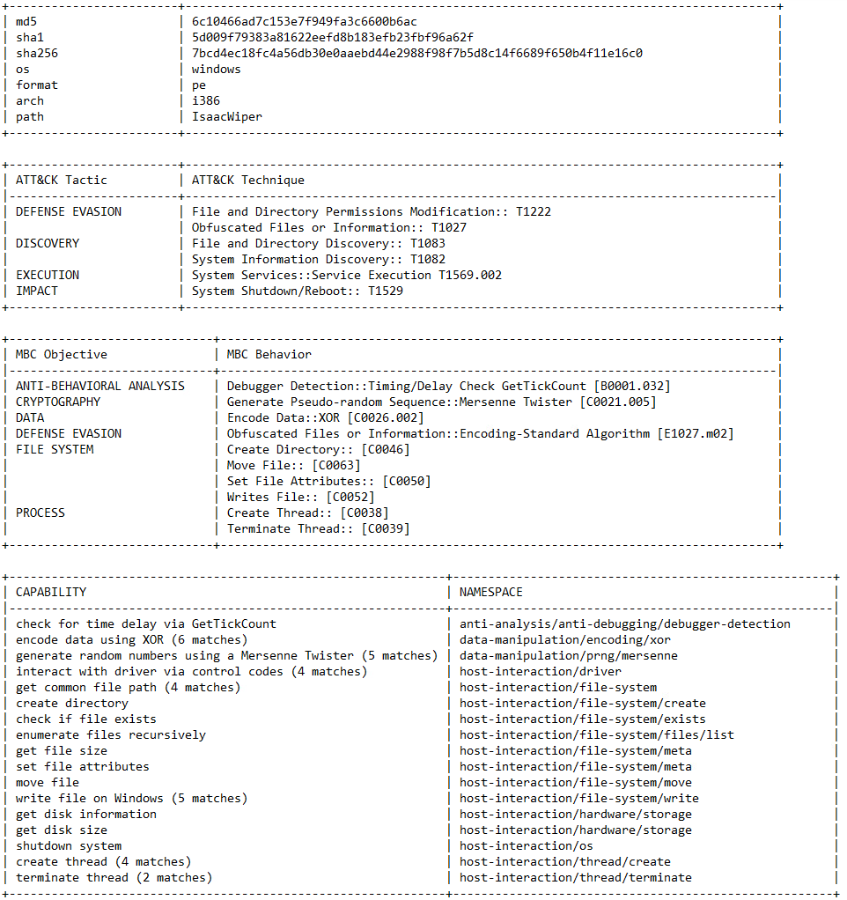
ISAACWiper Static Analysis (CAPA)

Slide 30
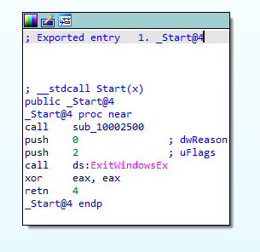
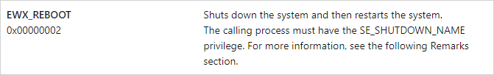
Reversing ISAACWiper (_Start@4)
Call sub_10002500
Reboot
Reference: https://learn.microsoft.com/en-us/windows/win32/api/winuser/nf-winuser-exitwindowsex

Slide 31
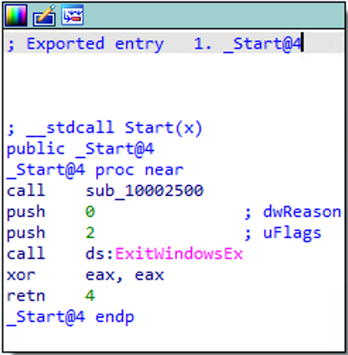
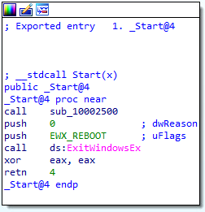
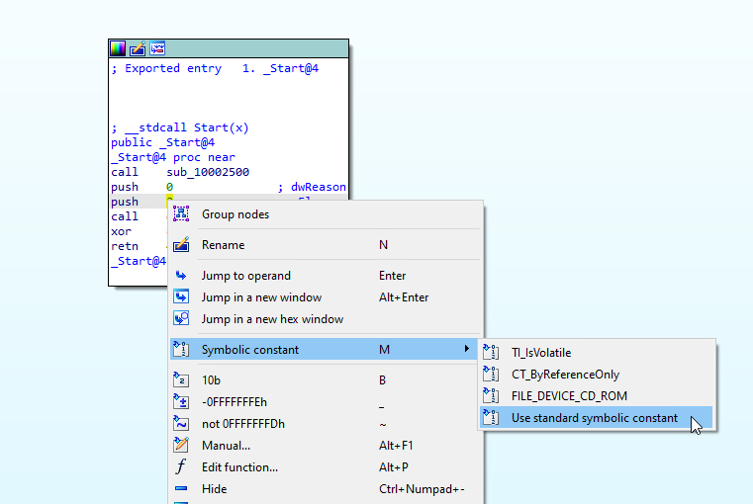
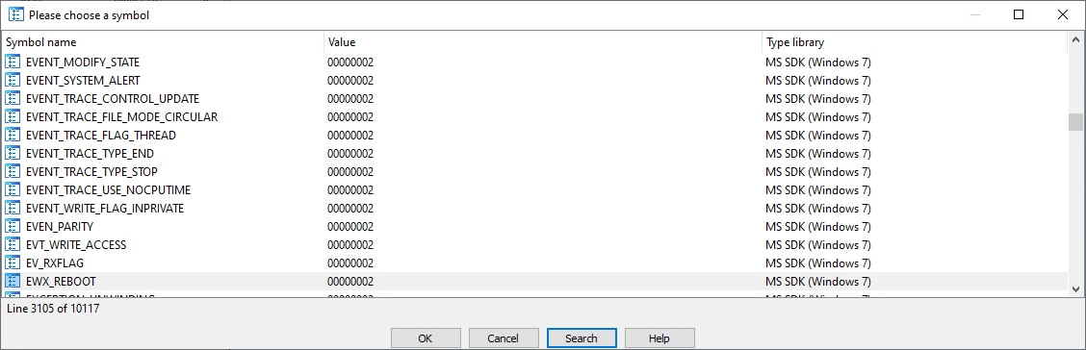
Reversing ISAACWiper (Symbolic Constants)

Slide 32
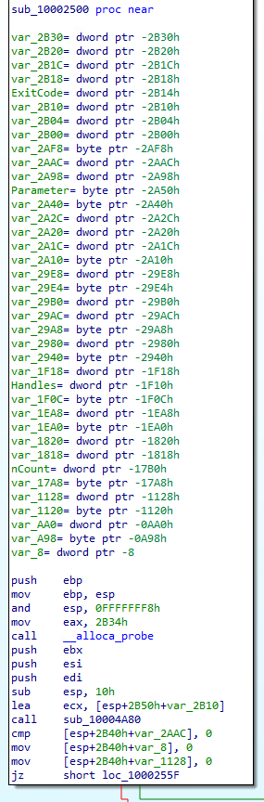
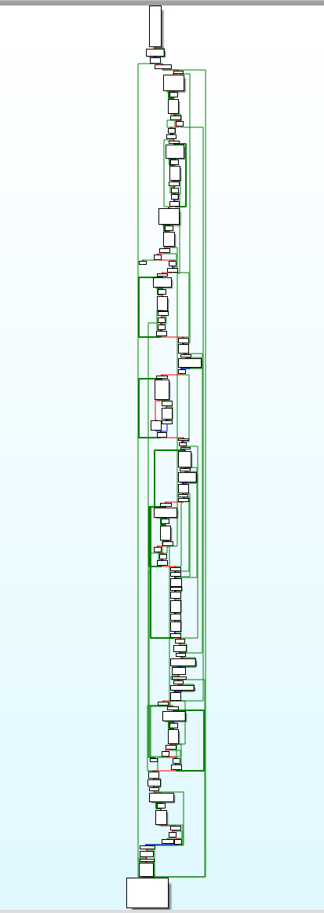
Reversing ISAACWiper (2500)

Slide 33
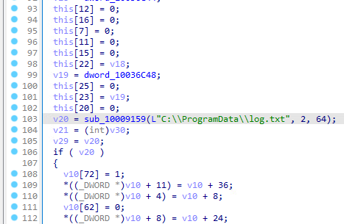
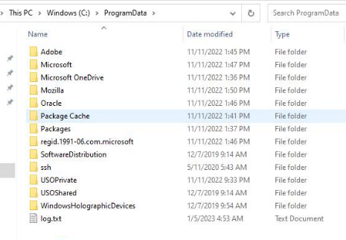
Reversing ISAACWiper (4A80)

Slide 34
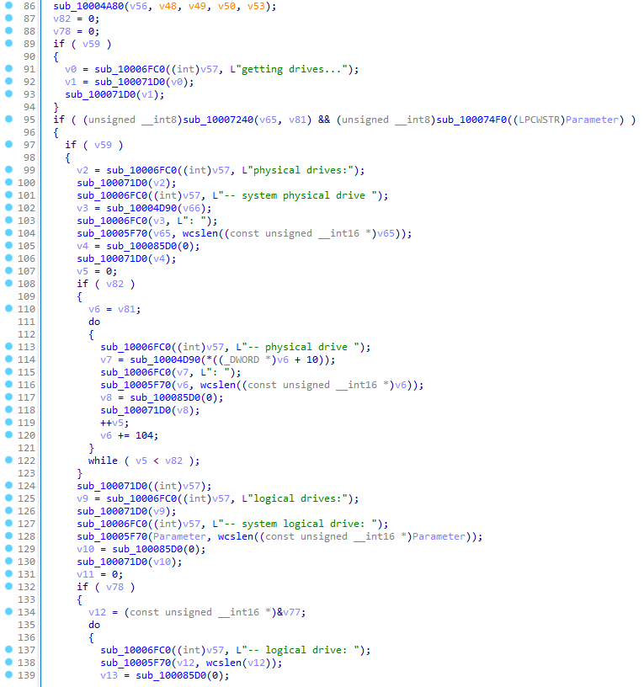
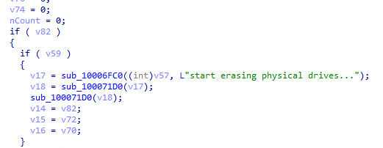
Reversing ISAACWiper (2500 DBG Strings)
Create log.txt

Slide 35
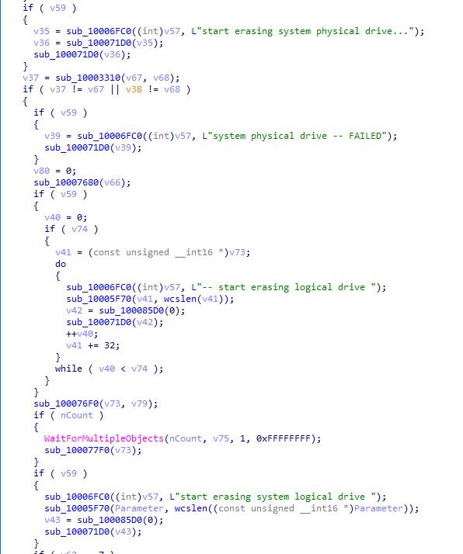
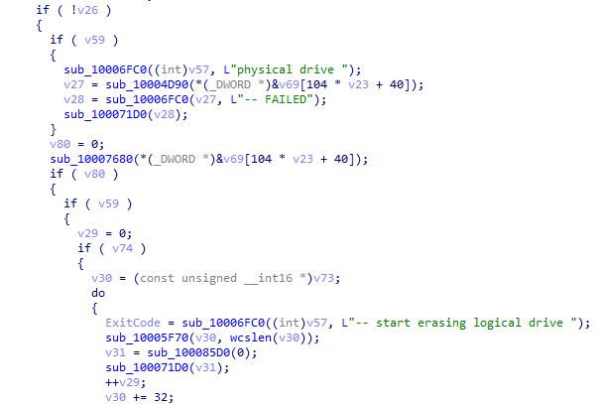
Reversing ISAACWiper (2500 DBG Strings 2)

Slide 36
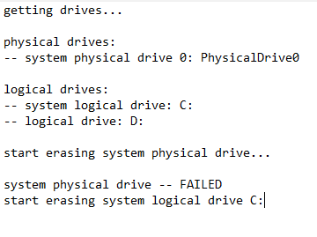
Reversing ISAACWiper (log.txt)

Slide 37
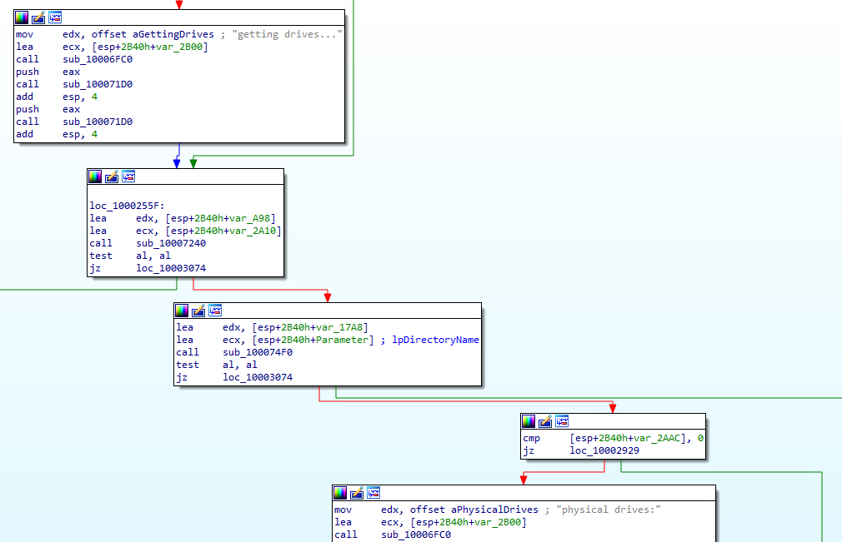
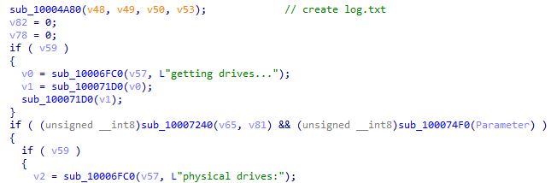
Reversing ISAACWiper (7240-74F0 Conditionals)

Slide 38
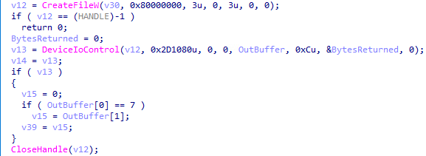
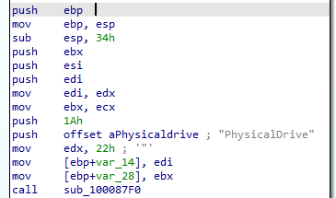


Reversing ISAACWiper (7240)
Get the list of physical drives (0-n)
dwIoControlCode
Reference: https://learn.microsoft.com/en-us/windows-hardware/drivers/kernel/specifying-device-types
Reference: https://learn.microsoft.com/en-us/windows-hardware/drivers/ddi/wdm/ns-wdm-_device_object
Reference: https://learn.microsoft.com/en-us/windows-hardware/drivers/ddi/ntddstor/ni-ntddstor-ioctl_storage_get_device_number

Slide 39

Reversing ISAACWiper (7240: DeviceIoControl)
Reference: https://learn.microsoft.com/en-us/windows/win32/api/ioapiset/nf-ioapiset-deviceiocontrol

Slide 40


Reversing ISAACWiper (7240 cont.)
Reference: https://learn.microsoft.com/en-us/windows/win32/api/fileapi/nf-fileapi-getdiskfreespaceexw

Slide 41


Reversing ISAACWiper (74F0)
Get partition of physical drive (n)
Reference: https://learn.microsoft.com/en-us/windows/win32/api/winioctl/ni-winioctl-ioctl_disk_get_drive_geometry_ex

Slide 42


ISAACWiper Wiping Operations (3310)
Reference: https://learn.microsoft.com/en-us/windows/win32/api/winioctl/ni-winioctl-fsctl_lock_volume

Slide 43



ISAACWiper Wiping Operations (3310 cont.)
Python “twist” implementation
Pseudocode “twist” implementation
Reference: https://blog.ollien.com/posts/reverse-mersenne-twister/
Reference: https://github.com/python/cpython/blob/main/Modules/_randommodule.c#L25

Slide 44


ISAACWiper Wiping Operations (3310 cont.)

Slide 45

ISAACWiper Wiping Operations (2500 cont.)

Slide 46

ISAACWiper Wiping Operations (39F0)
Mersenne Twister Algorithm

Slide 47



ISAACWiper Wiping Operations (GetTempFileNameW)
GetTempFileNameW(“.”, ”Tmf”, TickCount, “.”)
Reference: https://learn.microsoft.com/en-us/windows/win32/api/fileapi/nf-fileapi-gettempfilenamea

Slide 48



ISAACWiper Wiping Operations (3700)
Sub_10003560

Slide 49

ISAACWiper Execution

Slide 50




ISAACWiper Execution cont.

Slide 51
ISAACWiper Recap
Start
Create log.txt
Get physical drives
Get partitions and drive data
Overwrite physical drives with 10k bytes of PRNG data
Using 1 thread, create a file named “TmdXXXX/TmfXXXX.tmp and write to it using PRNG data until disk is full
End
Recursively wipe first 10k bytes of all files with PRNG data

Slide 52

ISAACWiper
MersenneTwisterWiper

Slide 53

YARA Signature (ISAACWiper)

Slide 54
Case Study: Azov Ransomware)

Slide 55


Most Complex And Capable in the Timeline
A new and destructive 'Azov Ransomware' data wiper is being heavily distributed through pirated software, key generators, and adware bundles, trying to frame well-known security researchers by claiming they are behind the attack.
The ransom note, named RESTORE_FILES.txt, says that devices are encrypted in protest of the seizure of Crimea and because Western countries are not doing enough to help Ukraine in their war against Russia.

Slide 56

What is AZOV RANSOMWARE?
Virus
Encrypted
Wiper
Logic Bomb
Polymorphic
Malware
Ransomware
Effective, fast, and unfortunately unrecoverable data wiper
Using anti-analysis and code obfuscation techniques
Multi-threaded intermittent Wiper
Polymorphic way of backdooring 64-bit “.exe” files across the compromised system
“logic bomb” set to detonate at a certain time. The sample analyzed below was set to detonate at 10-27-2022 10:14:30 AM UTC
No network activity and no data exfiltration

Slide 57

What it do?

Slide 58


What it do

Slide 59




Yara Signature

Slide 60

VirusTotal Query (Azov)
VirusTotal query – Azov-related samples
(behaviour:'Local\\\\Kasimir_*’
OR behaviour:'Local\\\\azov’)
AND
(behaviour_files:'RESTORE_FILES’
OR behaviour_registry:'rdpclient.exe’)

Slide 61
Postmortem and Recommendations

Slide 62
The Cost of Cyberwarfare
Ukrainian President Volodymyr Zelensky accused Russia of ‘energy terrorism’ and said that about 4.5 million Ukrainian consumers were temporarily disconnected from the power supply.
Also referred to the water shortages.
includes a hack, which the White House blamed on the Kremlin, that disrupted satellite internet communications in Ukraine on the eve of Russia’s invasion.
In 2017, NotPetya wiped computer systems at companies across Ukraine before spreading around the world; The incident cost the global economy billions of dollars by disrupting shipping giant Maersk and other multinational firms.
Groups are currently working on some high-complexity attacks that we will observe later.

Slide 63
Recommendations for users & organizations
Know what your critical assets are and what software is running on them.
Keep your software up to date. Prioritize patching critical and high vulnerabilities that allow remote code execution.
Enforce Multifactor Authentication (MFA) to the greatest extent possible.
Require the use of a password manager to generate strong and unique passwords for each separate account.
Backup all the essential files on the cloud and external drives and regularly maintain them.
Train your employees to recognize phishing emails, suspicious websites, infected links or other abnormalities to prevent successful compromise of email accounts.

Slide 64
References
https://arstechnica.com/information-technology/2022/12/never-before-seen-malware-is-nuking-data-in-russias-courts-and-mayors-offices/
https://avertium.com/blog/hermeticwizard-hermeticransom-isaacwiper-target-ukraine
https://bitdefender.com/blog/hotforsecurity/russian-courts-attacked-by-crywiper-malware-that-poses-as-ransomware/
https://bleepingcomputer.com/news/security/ukraine-says-russian-hacktivists-use-new-somnia-ransomware/
https://blog.checkpoint.com/2022/12/12/from-disruption-to-destruction-azov-ransomware-presents-a-new-shift-towards-destructive-wipers/
https://blog.ollien.com/posts/reverse-mersenne-twister/
https://blogs.vmware.com/security/2022/04/ruransom-a-retaliatory-wiper.html
https://cert.gov.ua/article/2724253
https://cert.gov.ua/article/38088
https://cert.gov.ua/article/39518
https://cisa.gov/uscert/ncas/analysis-reports/ar22-115b
https://crowdstrike.com/blog/how-to-decrypt-the-partyticket-ransomware-targeting-ukraine/
https://crowdstrike.com/blog/technical-analysis-of-whispergate-malware/
https://crowdstrike.com/blog/the-anatomy-of-wiper-malware-part-1/
https://crowdstrike.com/blog/the-anatomy-of-wiper-malware-part-2/
https://crowdstrike.com/blog/the-anatomy-of-wiper-malware-part-3/
https://crowdstrike.com/blog/the-anatomy-of-wiper-malware-part-4/
https://csis.org/analysis/cyber-war-and-ukraine
https://cyberconflicts.cyberpeaceinstitute.org/threats
https://cyberconflicts.cyberpeaceinstitute.org/threats/attack-details
https://cyberpeaceinstitute.org/ukraine-timeline-of-cyberattacks/
https://cyfirma.com/outofband/prestige-ransomware-analysis/
https://esentire.com/blog/esentire-threat-intelligence-malware-analysis-caddywiper
https://europarl.europa.eu/RegData/etudes/BRIE/2022/733549/EPRS_BRI(2022)733549_EN.pdf
https://fortinet.com/blog/threat-research/the-increasing-wiper-malware-threat
https://github.com/eset/malware-ioc/tree/master/ua_wipers
https://github.com/python/cpython/blob/main/Modules/_randommodule.c#L25
https://i.blackhat.com/USA-22/Wednesday/US-22-Cherepanov-Industroyer2-Sandworms-Cyberwarfare-Targets-Ukraines-Power-Grid-Again.pdf

Slide 65
References
https://iisf.ie/wiper-malware
https://inquest.net/blog/2022/04/07/ukraine-cyberwar-overview
https://learn.microsoft.com/en-us/windows-hardware/drivers/ddi/ntddstor/ni-ntddstor-ioctl_storage_get_device_number
https://learn.microsoft.com/en-us/windows-hardware/drivers/ddi/wdm/ns-wdm-_device_object
https://learn.microsoft.com/en-us/windows-hardware/drivers/kernel/specifying-device-types
https://learn.microsoft.com/en-us/windows/win32/api/fileapi/nf-fileapi-getdiskfreespaceexw
https://learn.microsoft.com/en-us/windows/win32/api/ioapiset/nf-ioapiset-deviceiocontrol
https://learn.microsoft.com/en-us/windows/win32/api/winioctl/ni-winioctl-fsctl_lock_volume
https://learn.microsoft.com/en-us/windows/win32/api/winioctl/ni-winioctl-ioctl_disk_get_drive_geometry_ex
https://learn.microsoft.com/en-us/windows/win32/api/winuser/nf-winuser-exitwindowsex
https://microsoft.com/en-us/security/blog/2022/10/14/new-prestige-ransomware-impacts-organizations-in-ukraine-and-poland/
https://msrc-blog.microsoft.com/2022/02/28/analysis-resources-cyber-threat-activity-ukraine/
https://politico.com/news/2022/12/07/estonia-ukraine-cybersecurity-russian-hackers-00072925
https://query.prod.cms.rt.microsoft.com/cms/api/am/binary/RE4Vwwd
https://research.checkpoint.com/2022/pulling-the-curtains-on-azov-ransomware-not-a-skidsware-but-polymorphic-wiper/
https://sentinelone.com/labs/acidrain-a-modem-wiper-rains-down-on-europe/
https://sentinelone.com/labs/hermetic-wiper-ukraine-under-attack/
https://splunk.com/en_us/blog/security/threat-update-doublezero-destructor.html
https://techtarget.com/searchsecurity/news/252528410/Check-Point-classifies-Azov-as-wiper-not-ransomware
https://trellix.com/en-us/about/newsroom/stories/research/wipermania-an-all-you-can-wipe-buffet.html
https://trendmicro.com/en_us/research/22/c/cyberattacks-are-prominent-in-the-russia-ukraine-conflict.html
https://trendmicro.com/en_us/research/22/c/new-ruransom-wiper-targets-russia.html
https://trustwave.com/en-us/resources/blogs/spiderlabs-blog/overview-of-the-cyber-weapons-used-in-the-ukraine-russia-war/
https://twitter.com/struppigel/status/1501473254787198977
https://unit42.paloaltonetworks.com/doublezero-net-wiper/
https://welivesecurity.com/2022/02/24/hermeticwiper-new-data-wiping-malware-hits-ukraine/
https://welivesecurity.com/2022/03/01/isaacwiper-hermeticwizard-wiper-worm-targeting-ukraine/
https://welivesecurity.com/2022/04/12/industroyer2-industroyer-reloaded/
https://zscaler.com/blogs/security-research/technical-analysis-partyticket-ransomware

Slide 66
Thank you!
Open for Q&A
Ashu.Sharma@watchguard.com
Ryan.Estes@watchguard.com

Slide 67
How it started
Stuxnet
We are safe
Unexpected Attack Vectors
Delay is detections

